Slide 1
Functional Programming
Rich Web Application Technologies

Slide 2
Programming Paradigms
A paradigm is a term meaning a way of doing things, such as programming
From a Web App perspective, there are five programming paradigms that you will encounter - although, formally, many more exist
Imperative | Control flow as an explicit sequence of commands
Procedural | Imperative style with procedure/function call support
Declarative | Code states the desired result but not how to get it
Object-oriented | Sending messages to objects which have state and behaviour
Functional | Computation by pure function calls that avoid any global state - based on Category Theory in mathematics
Notes:
Some well-known examples of declarative domain specific languages (DSLs) include CSS, regular expressions, and a subset of SQL (SELECT queries, for example) Many markup languages such as HTML, MXML, XAML, XSLT... are often declarative.

Slide 3
Functional Programming
The big idea in functional programming is the separation of the functions that operate on data from the data on which they operate
This separation lends itself to the idea of function composition where in chained pipelines of functions operate on data transforming at each stage and passing the results onto the next phase
The benefit is the resultant composition can implement potentially complex transformations in a very readable and maintainable way
The functional expression of a problem is often more obvious and easier to reason about

Slide 4
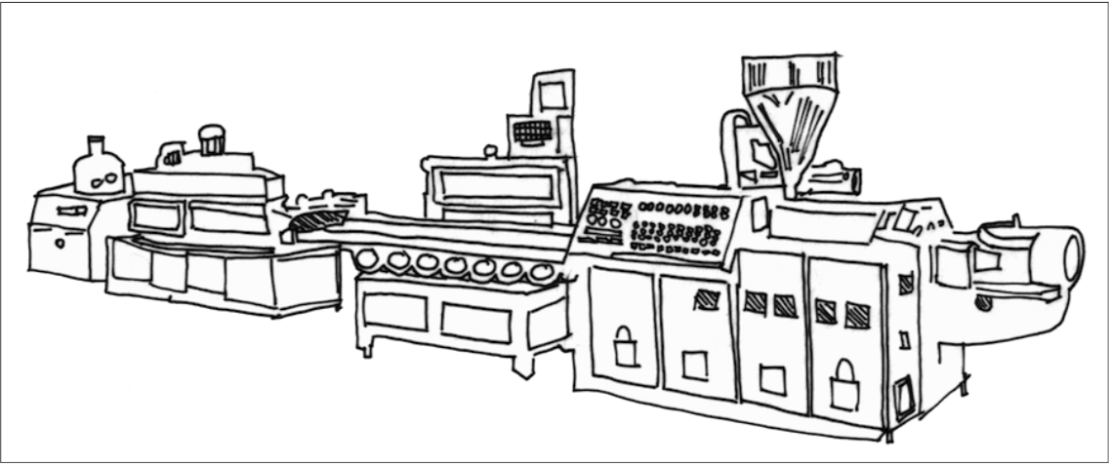
Functional Programming
This is a system built along functional principles.
Takes raw materials in one end, and gradually builds a product that comes out the other end

Slide 5
Pure Functions
Central to the idea of functional composition is the notion of so-called pure functions
A pure function operates on, but does not change, the values passed to it
The result of calling a pure function with the same values should be the same very time
That means that pure functions are not allowed to have side effects, i.e. alter something outside the function such as a variable
Pure functions produce new values as their results and don’t alter, in any way, their input values
I.e. pass-by-value semantics
Notes:
Show code snippet on side effect.

Slide 6
Functors
A functor is a data object can hold elements of any data type and which implements the map operation (a function)
The functor’s map() function takes, as an argument, another function and calls that function for each element of the functor resulting in a new functor
map()’ing over a functor always produces a new functor of the same size
// Javascript arrays are functors ['123', '456', '789'] .map(s => parseInt(s)) .map(n => n / 10) // => [12.3, 45.6, 78.9]
Notes:
Can chain – but not always efficient. Looping through the same elements in a list lots of times.
Show example here..

Slide 7
Monad
Search for monad on google = bombarded by impossible to decipher category theory maths. Need to understand following concepts:
Functors: map with context: F(a) => F (b) - Object with a map function.
Context: In the above example Functor is context, ie In Array(a) => Array(b), Array is context.
Type Lift: Lift a type into a Context, a => F(a) ie a => Array(b)
Flatten: Unwrap the value from the context, F(a) => a.
Flatmap : ‘maps’ and ‘flattens’ in one operation.
Ok, how is this practical? They make composition easier.
Notes:
Can chain – but not always efficient. Looping through the same elements in a list lots of times.
Show example here..

Slide 8
Monad Cont..
The whole reason functions exists is so we can compose them.
Function composition creates pipelines that your data flows through.
You put input in first stage of pipeline, and some data pops out the last stage of pipeline, transformed.
Composing with Functors, F(a) => F (b) => F(c)
//What if we wanted this method //signature though?
function f = F(a) => F(b)
function g = b => F(c)
// This wouldn’t work..
F(a).map(f).map(g)
// Flatmap to the rescue
//Consider two function signatures:
function f = F(a) => F(b)
function g = F(b) => F(c)
// You would compose like this
F(a).map(f).map(g)
Notes:
Can chain – but not always efficient. Looping through the same elements in a list lots of times.
Show example here..

Slide 9
Monad Cont..
Now, what if we wanted:
Under the hood, flatMap does a map + flatten
// Consider two function signatures:
function f = a => M(b)
function g = b => M(c)
// You would compose like this
f(a).flatmap(g)
// if we call f(a) we get M(b)
f(a) = M(b)
// flatmap then calls map(g) + flatten
M(b).map(g) // this gives us M(M(c))
// flatMap then calls flatten
M(M(c)).flatten // This gives what we want M(c)
Notes:
Can chain – but not always efficient. Looping through the same elements in a list lots of times.
Show example here..

Slide 10
Filter
Filter calls a predicate function (one returning a true or false value) and grabs each value where said predicate returned true, returning them in a new collection
A predicate is a function that returns a boolean value.
An example, Suppose we want to get the list of books with ratings higher than 4.5
let books1 = [{id: 1,name: ‘book 1’, rating : 5}, {id: 2, name: ‘book 2’, rating: 3}];
books.filter(book => book.rating >= 4.5)
Notes:
Where is the predicate here?
Add another filter example in jsbin for name === ‘book 1’ or similar.

Slide 11
Reduce
Reduce executes a reducer function (that you provide) on each element of the array, resulting in a single output value.
Takes two arguments, an accumulator (acc below) and a current value (current) .
The functions (adder) returned value is assigned to accumulator, whose value is remembered across each iteration, eventually becoming the final result value.
// traditional way
let numbers = [2,5,6,1,10],result=0;
for (var num of numbers) {
result = result + num;
}
console.log(result); // 24
// reduce
let numbers = [2,5,6,1,10];
const adder = (acc, current) => acc + current;
Numbers.reduce(adder);
Notes:
Where is the predicate here?
Add a multiplier function to this example

Slide 12
Higher Order Functions
JS supports the concept of higher order functions wherein a function can accept another function as an argument or return a function as a value
In other words functions are just values, like objects or primitives
const myHandlerFunc = (event) => { // do something with event ... } document.addEventHander('click', myHanderFunc);

Slide 13
Function Closures
A closure is a function which closes over one or more values which would otherwise have gone out of scope when the closure was created
const makeLookup = (attr) => { const table = [ {name: 'cherries', quantity: 1000}, {name: 'apples', quantity: 2050}, ]; return (name) => { return table.filter(fruit => fruit.name === name) .map(fruit => fruit[attr]); } } const lookupQuantity = makeLookup('quantity'); console.log(lookupQuantity('apples'));

Slide 14
Function Closures Cont..
Closures are a way to implement data hiding, which can lead to modules and other nice features.
The key concept is when you define a function, it can refer to not only its own local variables in block scope, but also everything outside the context of the function. Ie count is accessible in nested myFunction below
function newCounter() { let count = 0; return myFunction() { count = count+1; return count; } }

Slide 15
Function Currying
A curried function is a function where the evaluation of its arguments is translated into a sequence of functions which evaluates one argument at a time, so instead of someFunction(a,b), it becomes someFunction(a)(b)
The intermediate functions can form partial evaluations for later use
// Conventional approach const multiply = (x, y) => x * y; const curriedMultiplier = x => y => x * y; const discount = curriedMultiplier(0.98); console.log(discount(1000)); // => 980

Slide 16
Another Currying example
const curriedSubstring = start => length => str => str.substr(start, length); const alwaysStartFirstChar = curriedSubstring(0); // What is this going to print - try it out in JsBin console.log(alwaysStartFirstChar(2)('Hello'));

Slide 17
Lazy Evaluation
Lazy evaluation is the idea that a function defers computing a result until it absolutely needs to
This makes memory or compute intensive functions more efficient
Consider below, what’s wrong with it?
We ran a very demanding function at the beginning to use its returned value at the end of the program. Blocking call. Potentially block browser
const someValue = expensiveFunction(); // Tons of operations that don't involve someValue console.log(someValue);

Slide 18
Lazy Evaluation Cont..
This simple problem would be fixed by reordering. However, no all this simple.
This makes memory or compute intensive functions more efficient
In JS, the ES6 generator function can be used to achieve this
What are ES6 generator functions?
a generator is a function that can stop midway and then continue from where it stopped.
A generator object is an iterator. Iterators are lazy because the next value in the sequence is only created/calculated when it is consumed.

Slide 19
Generator Functions
function * generatorFunction() { console.log('This will be executed first.’); yield 'Hello, ‘; console.log('I will be printed after the pause’); yield 'World!’; } const generatorObject = generatorFunction(); console.log(generatorObject.next().value); console.log(generatorObject.next().value); console.log(generatorObject.next().value);

Slide 20
Lazy Evaluation Cont..
const someValue = lazyFunction(); // Tons of operations that don't involve someValue console.log(someValue.next(); // Now invoked when needed.

Slide 21
Immutability
The functional programming paradigm enforces the notion of immutability wherein, once set, a variable’s value never changes - only new copies are created
So we don’t really have variables but rather symbol bindings
const sum = (arr) => { let sum = 0; for (let n of arr) { sum += n; } return n; } const n = sum([1, 2, 3]); // => 6
const sum = (arr, acc) => { if (arr.length === 0) return acc; return sum(arr.splice(1), arr.shift() + acc); } const n = sum([1, 2, 3], 0); // => 6

Slide 22
Recursion
function factorial(x) { // TERMINATION if (x < 0) return; // BASE if (x === 0) return 1; // RECURSION return x * factorial(x - 1); } factorial(3);
When a function calls itself
Three keys of recursion
A termination condition
A base case
The recursion

Slide 23
Recursion – Another example
function revStr(str){ if (str === '') return ''; return revStr(str.substr(1)) + str[0]; } revStr('cat');
What is the termination, base and recursive magic happening?
Step by step
revStr('cat') //returns revStr('at') + 'c' revStr('at') //returns revStr('t') + 'a' revStr('t')// returns revStr('') + 't' revStr('')// returns ’’
It will process these in reverse order to get ‘t’ ‘a’ ‘c’
Notes:
str === "" is our base case. When our string has no characters in it, we’ve succeeded.
return revStr(str.substr(1)) + str[0]; is where the recursion magic happens.
There is no termination case. That’s because in this instance our base case is our termination case. We can’t get a string that has negative characters. so as long as only strings are entered into our function we will be fine.
Lets work through another example
function myLen(str) {
if (str === '') return 0
function myLen(str, counter) {
if (str === '') return counter;
else {
counter = counter + 1;
return myLen(str.substr(1), counter);
}
}
return myLen(str, 0);
}

Slide 24
Structural Sharing
Because functional languages use copies of values rather than mutated values you might be concerned about the inefficient use of memory
For example a 10,000 element array needing fully copied just to change the value of one of its elements
In practice, most functional programming languages implement their data structures using a technique known as structural sharing
The new and old copies share most of their contents and only the differences distinguish them
Under the hood, the implementation rely on data structures like tries which incur a small but practically insignificant overhead to maintain

Slide 25


Functional Programming in Javascript
So how does Javascript rate as a functional programming language?
Higher-Order Functions
Function Closures
Curried Functions
Lazy Evaluation (generators)
Immutability (const and recursion)
Native Structural Sharing

Slide 26
Summary
Of the many programming paradigms you will encounter in computer science, the functional paradigm, which is based on Category Theory in mathematics, emphasises composable operations on data
Not surprisingly, functions are the basic building block
Functors are any-type data collections which implement a map() operation capable of return new functors (of possibly different types)
Functional programming allows solutions to be easily composed, be more declarative and obvious, be easier to reason about and be easier to get right and debug if wrong

